Slide 1
DSA Project Evaluation Criminal Management System
Group 43
EG/2021/4424- BALASOORIYA JM
EG/2021/4432- BANDARA KMTON
EG/2021/4433- BANDARA LRDT

Slide 2
Introduction
Attributes
functions
prison_name
guardian_name
guardian_contact
criminal_info
Add criminal
Search criminal
Count criminal
Update criminal
Remove criminal
Show criminal

Slide 3
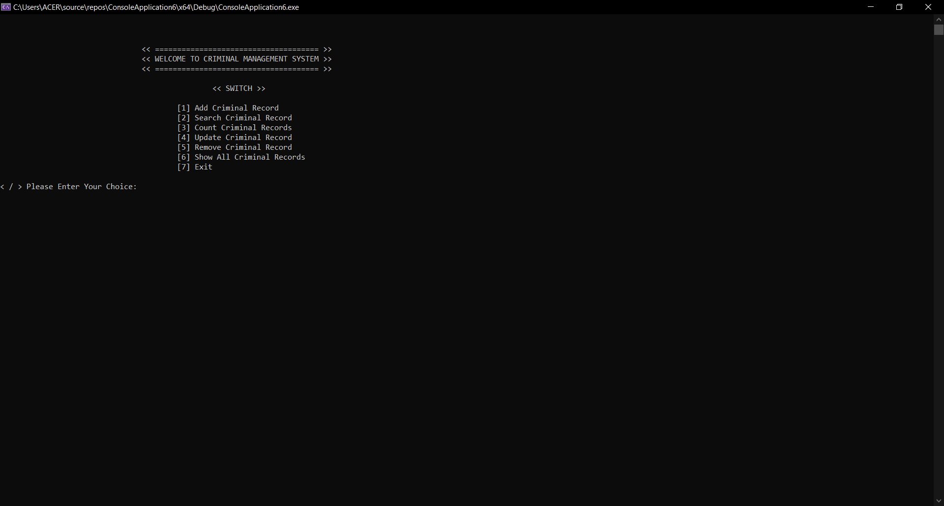
Interface
That’s the interface of console

Slide 4
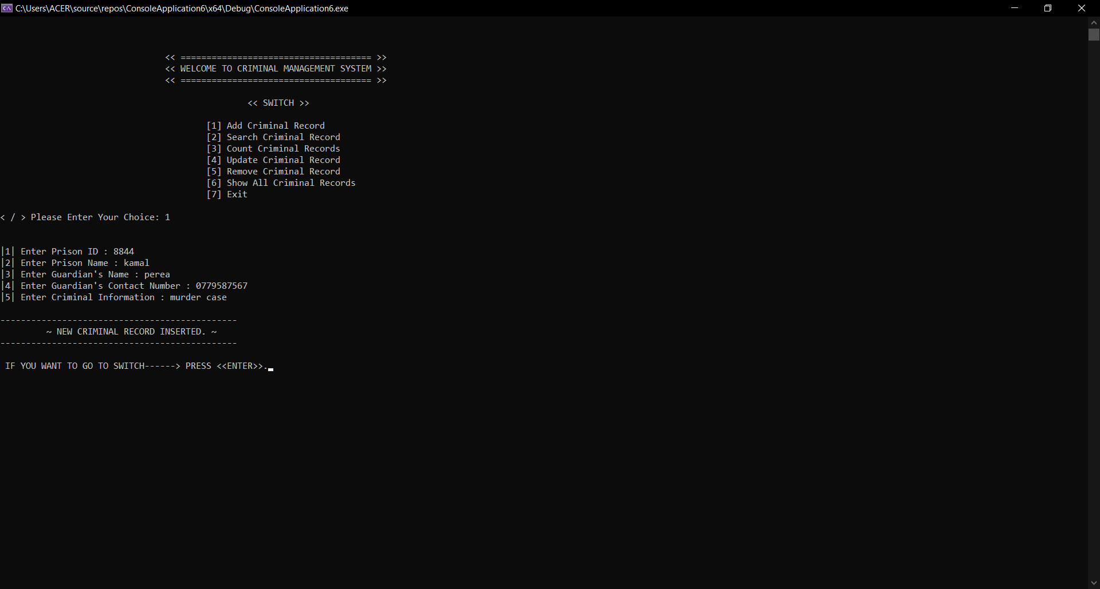
Add Criminal Record
Function to add new criminal records to the linked list.

Slide 5
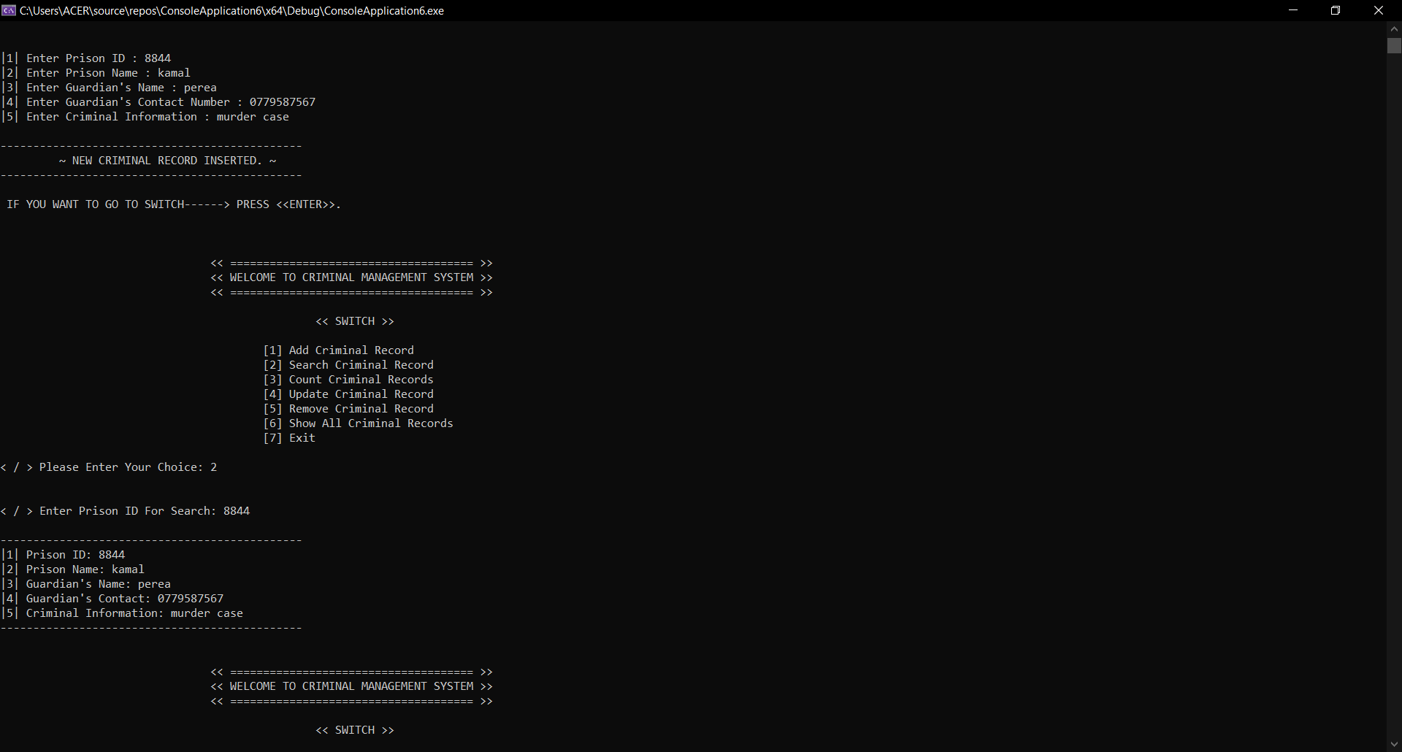
Search Criminal Record
Function to find criminal records based on Prison ID.

Slide 6
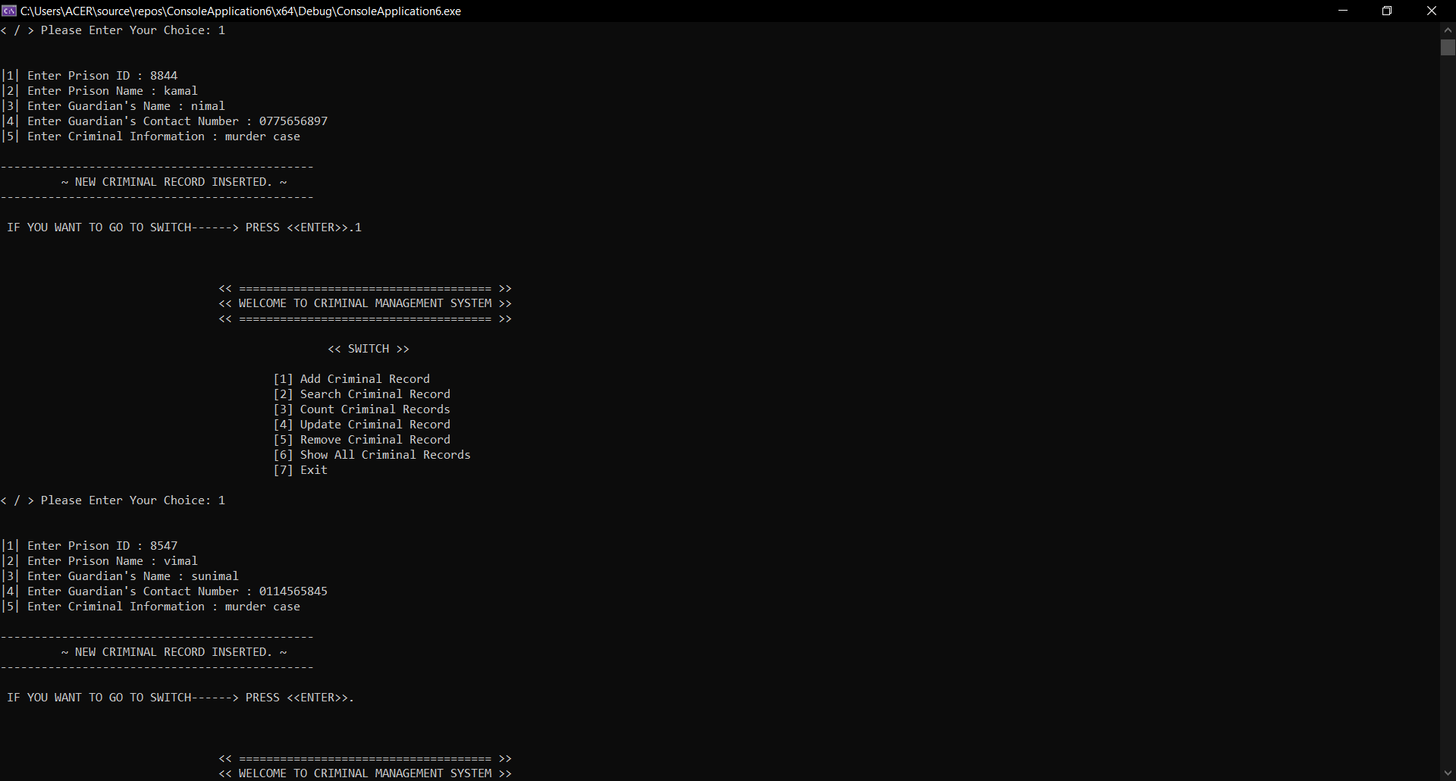
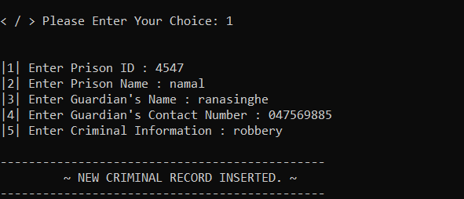
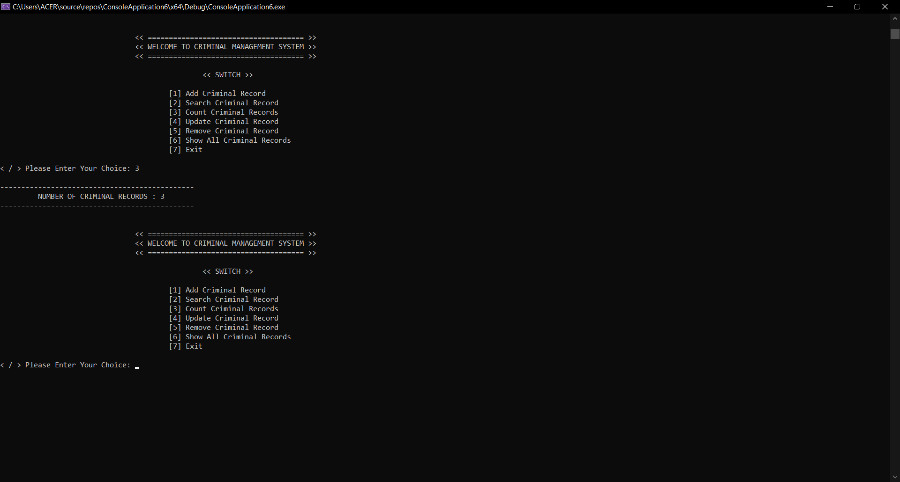
Count Criminal Records
Function to count the number of criminal records in the linked list.

Slide 7
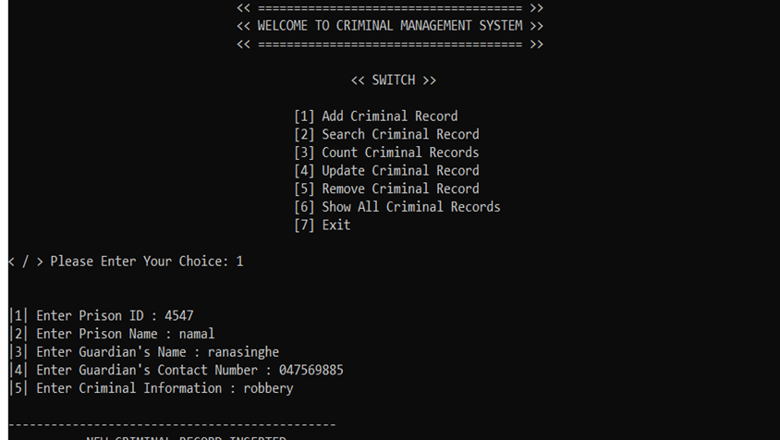
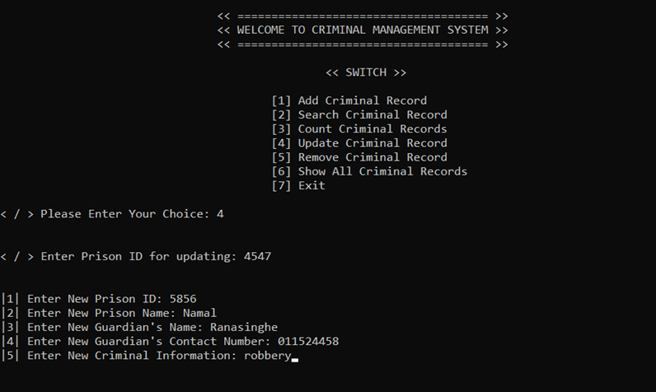
Update Criminal Record
Function to update existing criminal records based on Prison ID.
before the updating
After the updating

Slide 8
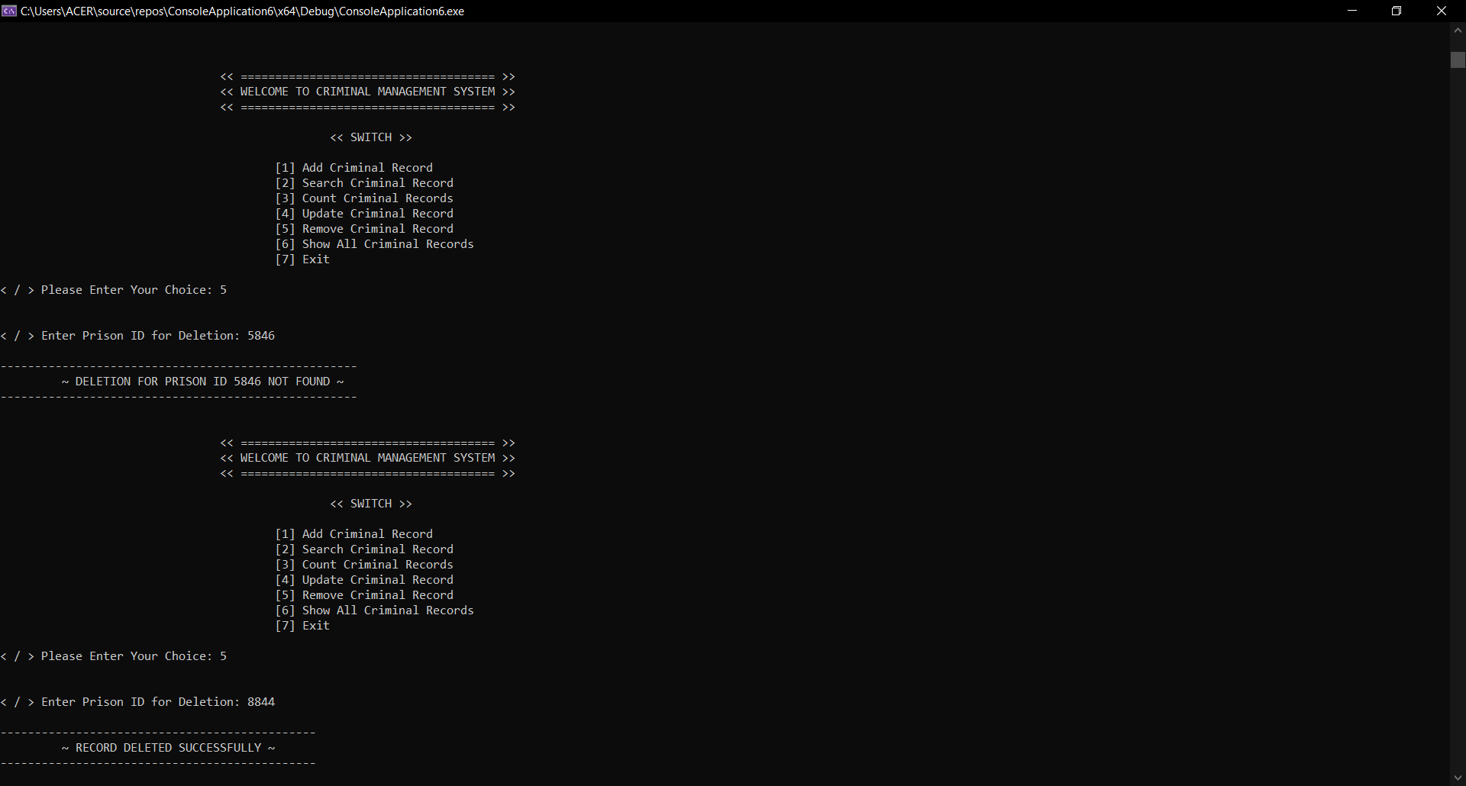
Remove Criminal Record
Function to delete criminal records based on Prison ID.
Invalid Prison_ID

Slide 9
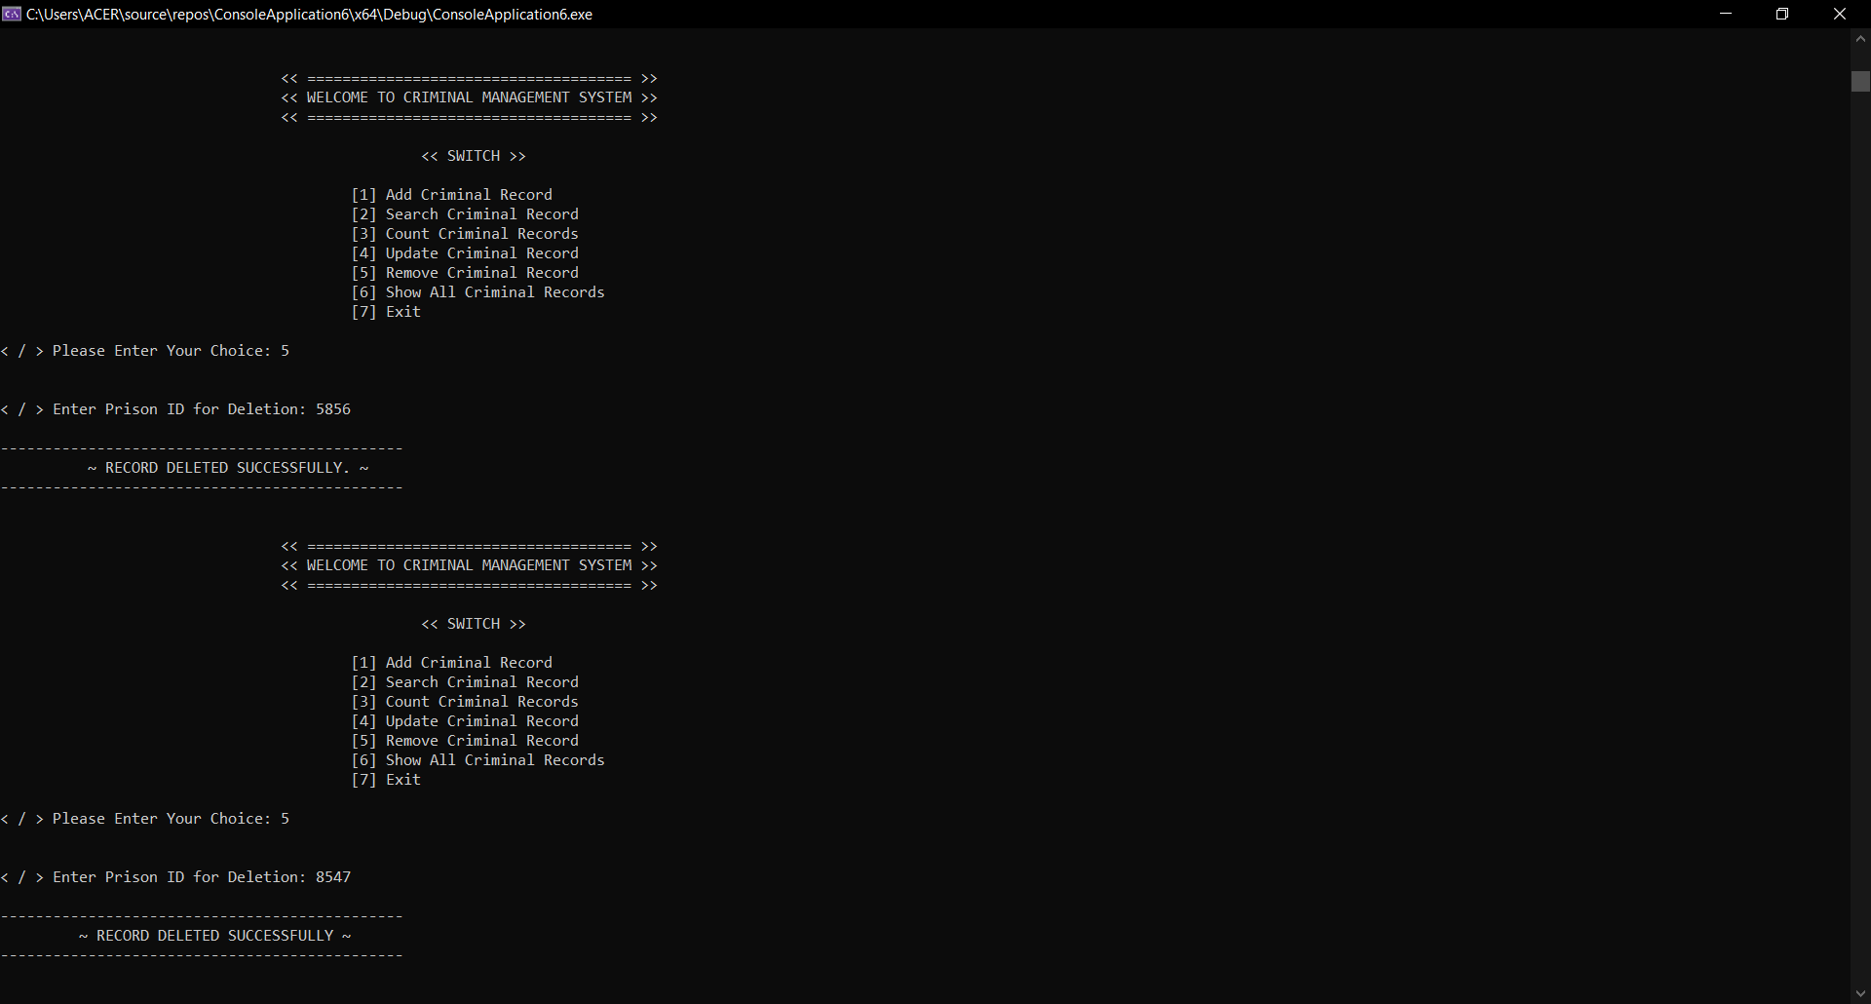
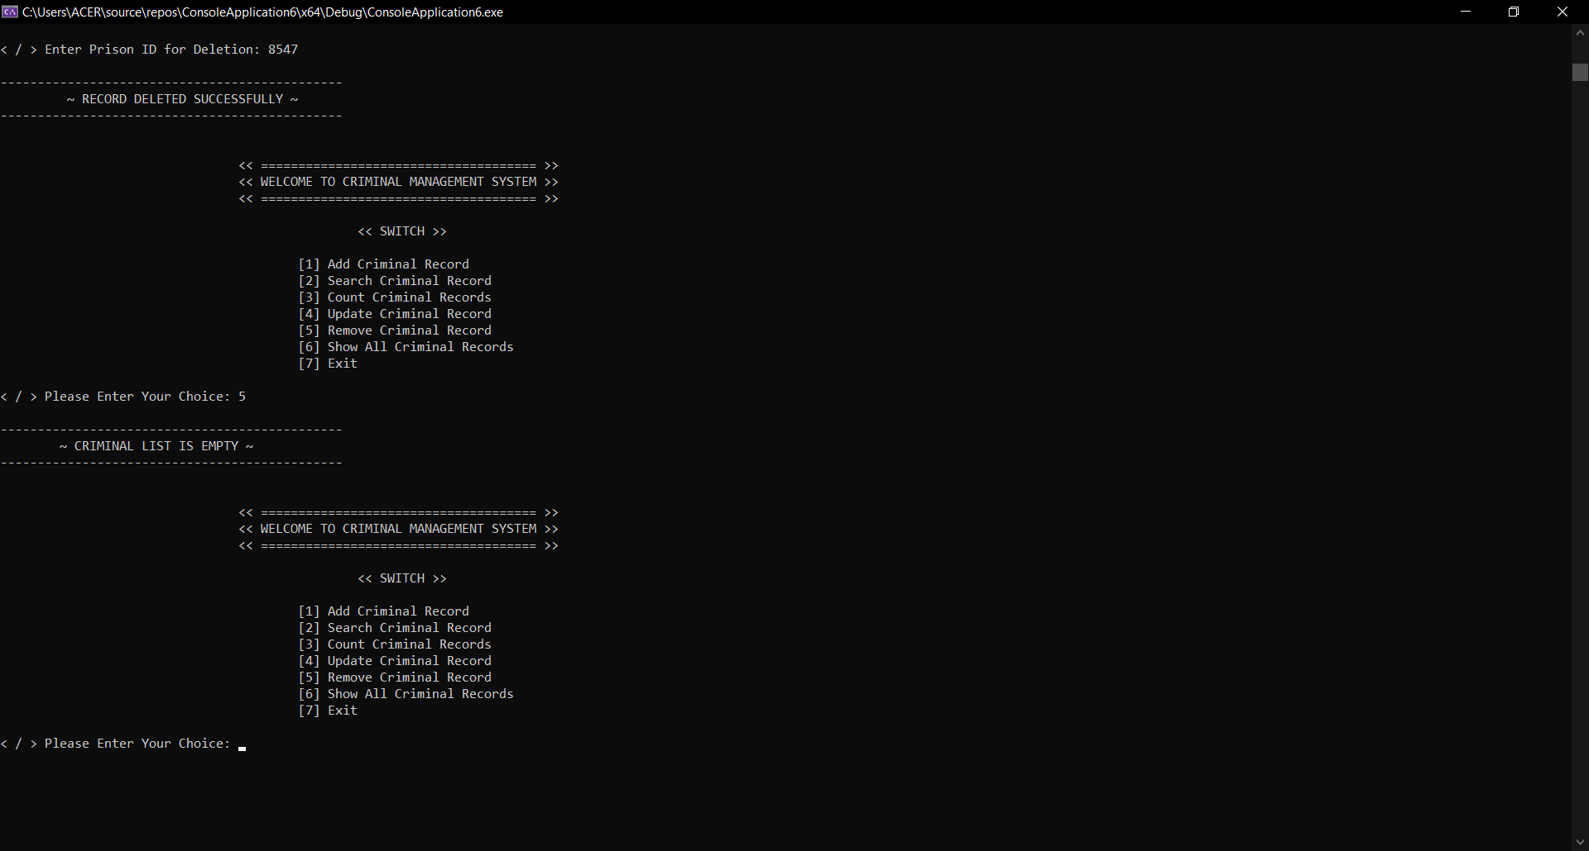
Deleting 1
Deleting 2
Deleting 3
Deleting 4

Slide 10
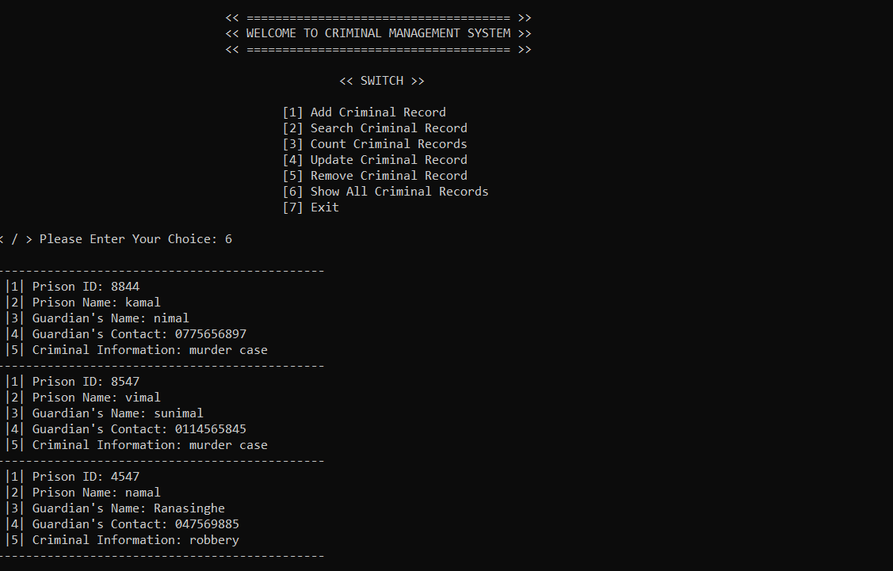
Show All Criminal Records
Function to display all criminal records in the linked list.

Slide 11
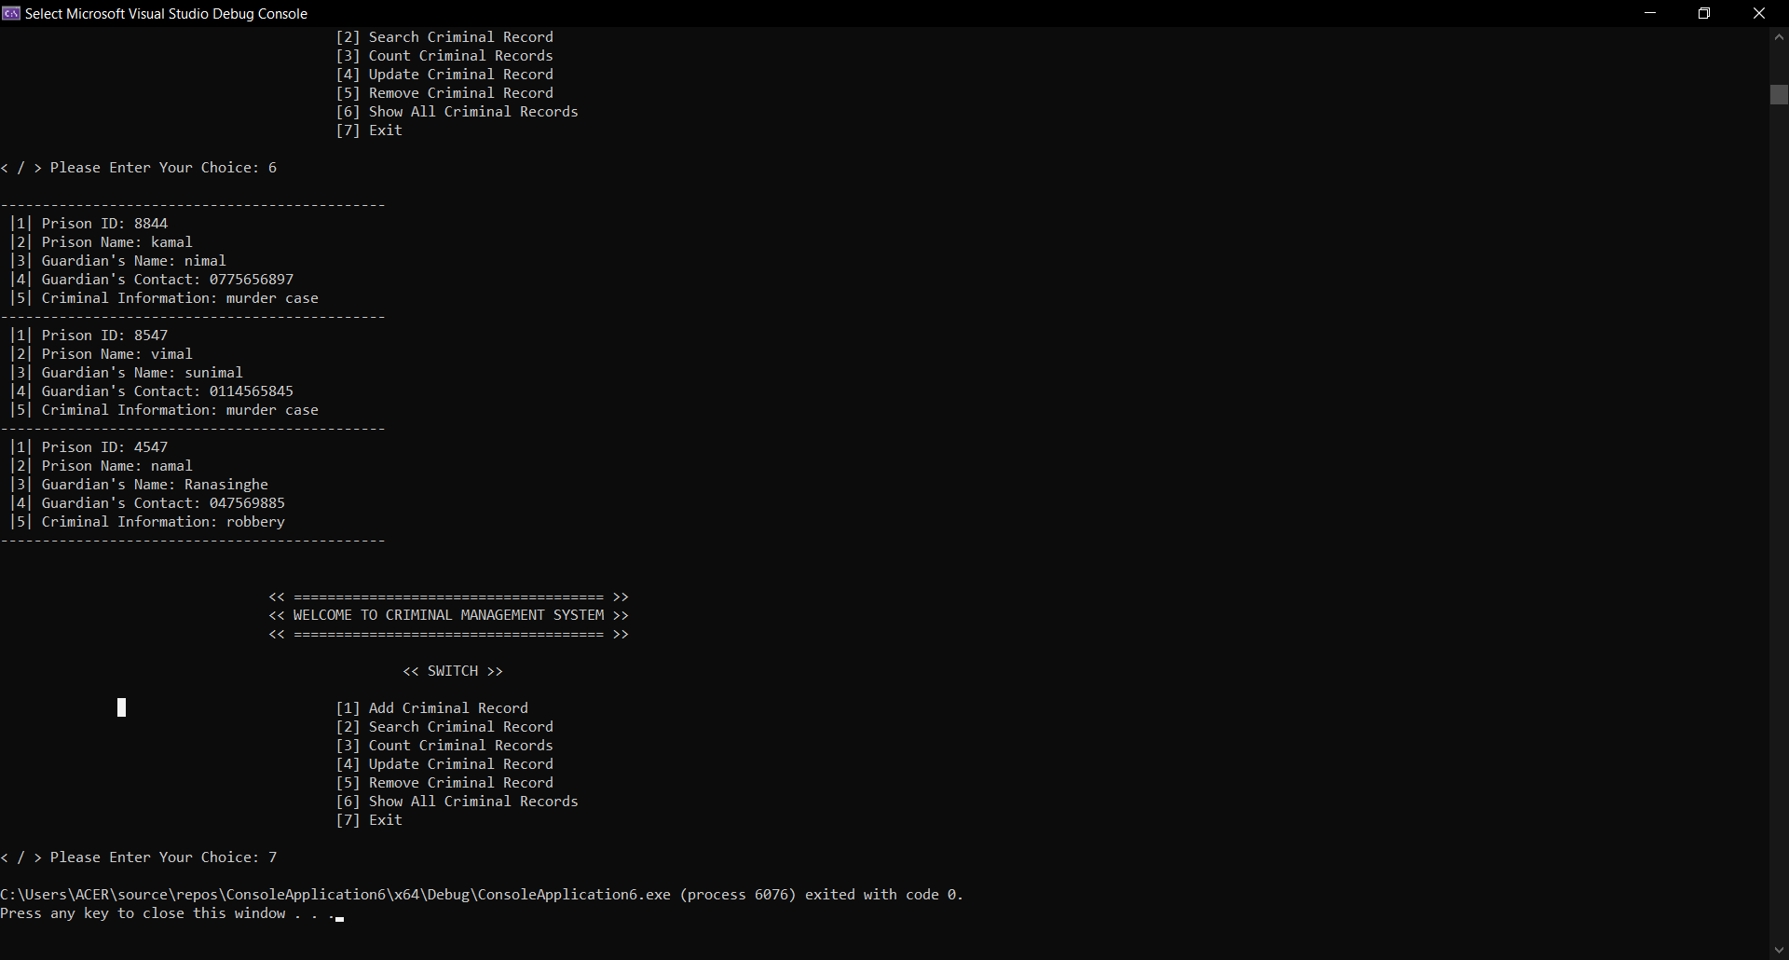
Exit
This function use to exit the console

Slide 12


